Slide 1
What is Organizational Behavior?

Slide 2
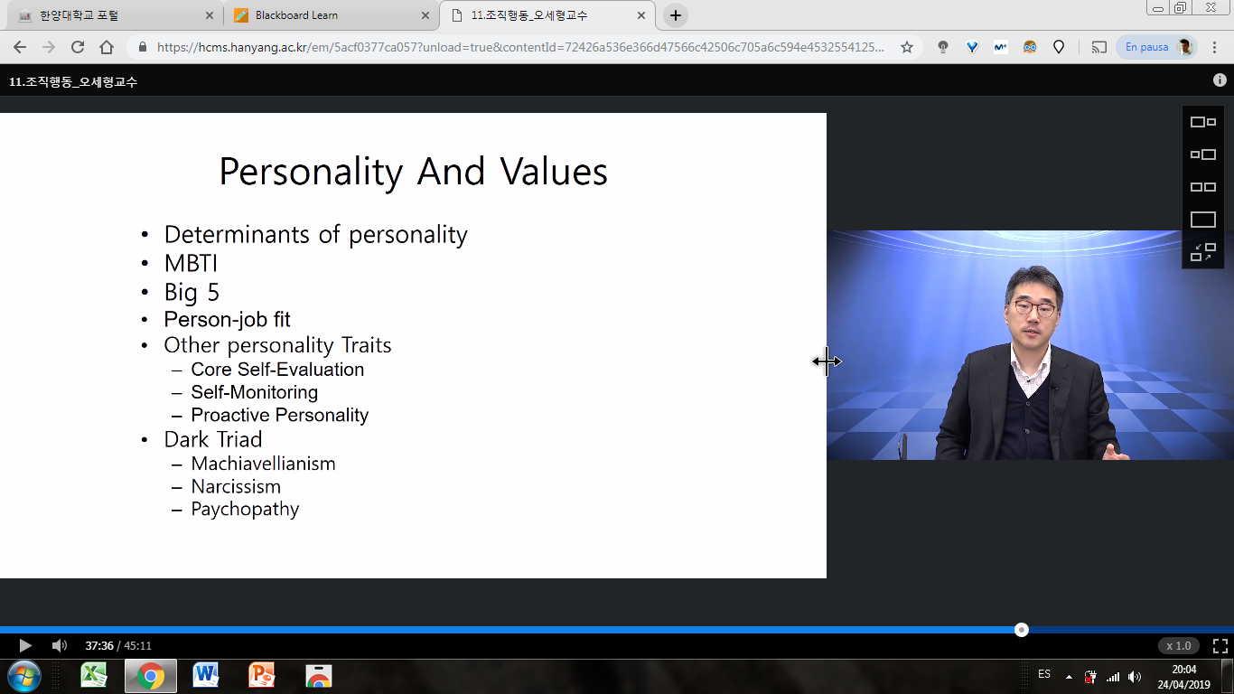

Slide 3
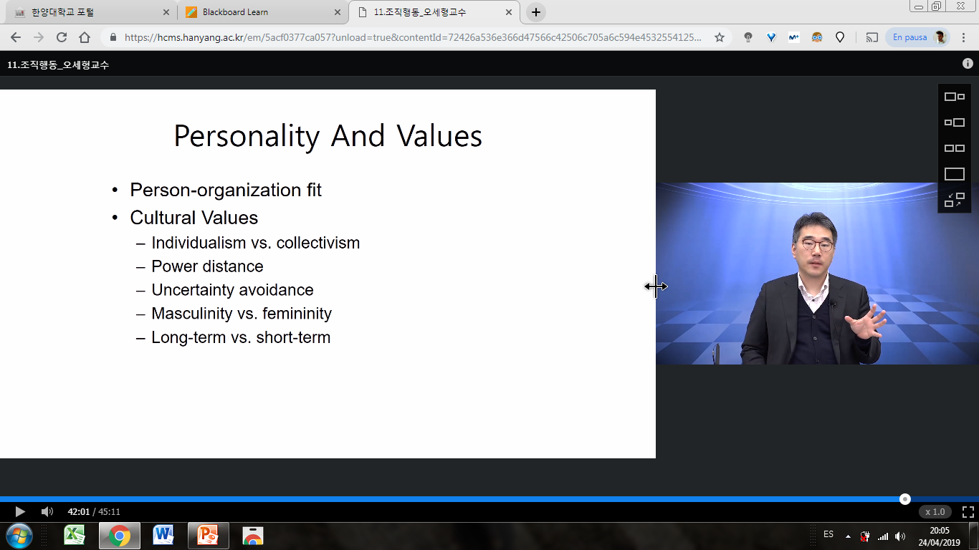

Slide 5
Working experience

Slide 6
Common problems
Communication
Leadership
Motivation
Relationship
Etc.

Slide 7
Common problems
Communication
Leadership
Motivation
Relationship
Etc.
How to solve problems?

Slide 8
Common problems
Communication
Leadership
Motivation
Relationship
Etc.
How to solve problems?
Know the reasons

Slide 9
Apple
Core competencies?

Slide 10
Apple
Core competencies?
Let’s listen to Steve Jobs
Notes:
https://www.youtube.com/watch?v=f60dheI4ARg

Slide 11
Apple
Let’s listen to Steve Jobs
Three key factors
Notes:
https://www.youtube.com/watch?v=f60dheI4ARg

Slide 12
Apple
Let’s listen to Steve Jobs
Three key factors
Trust
Communication
Empowerment
Notes:
https://www.youtube.com/watch?v=f60dheI4ARg

Slide 13
Apple
Let’s listen to Steve Jobs
Three key factors
Trust
Communication
Empowerment
Teamwork
Notes:
https://www.youtube.com/watch?v=f60dheI4ARg

Slide 14
Apple
Let’s listen to Steve Jobs
Three key factors
Trust
Communication
Empowerment
Teamwork
Motivation
Notes:
https://www.youtube.com/watch?v=f60dheI4ARg

Slide 15
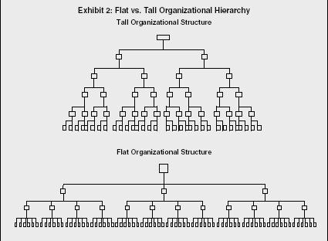

Slide 16
Making innovative company
How to manage people

Slide 17
Making innovative company
How to manage people
Importance of understanding how people think and behave in the organizational environment

Slide 18
Importance of understanding how people think and behave in organizational context
→ great managers

Slide 19
Organizational Behavior
OB is a field of study that investigates various factors (individuals, groups, organizational structure, etc.) that influence people behavior within organizations for the purpose of applying such knowledge toward improving an organization’s effectiveness

Slide 20
Science
Systematic study
Study of cause and effect
Conclusion based on scientific evidence
Input
Processes
Output

Slide 21
Behavioral Science
Systematic study
Study of cause and effect
Conclusion based on scientific evidence
Input
Processes
Output

Slide 22
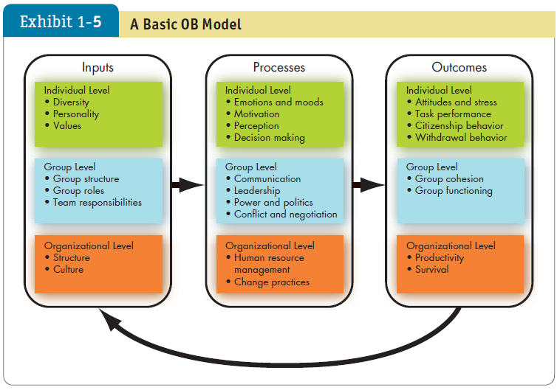
Organizational Behavior

Slide 23
Few Absolutes Apply to OB

Slide 24
Behavioral Science
Systematic study
Study of cause and effect
Conclusion based on scientific evidence
Situation Matters
Input
Processes
Output

Slide 25
Example
Email Monitoring
Acceptance by employees
Ethical vs. not ethical
Email Monitoring
?

Slide 26
Example
Email Monitoring
US
Email Monitoring
OK
KOREA
Email Monitoring
Unethical

Slide 27
Organizational Behavior
Application of results
→Evidence-Based Management (EBM)
Managers make decisions based on evidence.

Slide 28
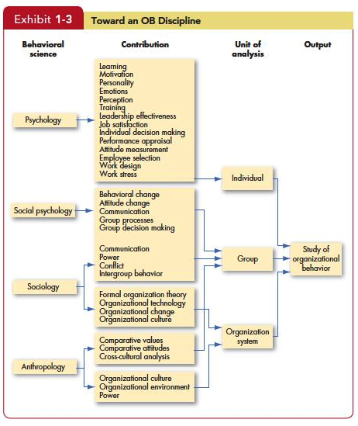

Slide 29
Challenges and Opportunties of OB
Responding to economic pressure
Retaining good employees
Good decision making
Globalization
Working with people from different cultures
Adapting to different culture
Diverse workforce
Gender, age, race, ethnicity, etc.
Enhancing Creativity
Networked organizations

Slide 30
Summary
Importance of understanding employees’ thinking and behavior
Organizational Behavior is the study of factors affecting organizational members’ thinking and behavior
OB is social science
People management should be evidence-based management

Slide 31
Summary
Input-process-output
Many challenges and opportunities of OB

